Slide 1
Back Propagation algorithm
AASHISH PANDEY

Slide 2



























Mathematical Modelling of Neural Network
$$x_{0}$$
$$w_{10}^{(1)}$$
$$x_{1}$$
$$w_{11}^{(1)}$$
$$a_{1}^{(2)}$$
$$a_{0}^{(2)}$$
$$a_{1}^{(2)}=g\{w_{10}^{\left(1\right)}x_{0}+w_{11}^{\left(1\right)}x_{1}+w_{12}^{\left(1\right)}x_{2}+w_{13}^{\left(1\right)}x_{3}\}$$
$$w_{31}^{(1)}$$
$$w_{21}^{(1)}$$
$$x_{0}$$
$$w_{11}^{(2)}$$
$$w_{10}^{(2)}$$
$$w_{20}^{(1)}$$
$$a_{2}^{(2)}=g\{w_{20}^{\left(1\right)}x_{0}+w_{21}^{\left(1\right)}x_{1}+w_{22}^{\left(1\right)}x_{2}+w_{23}^{\left(1\right)}x_{3}\}$$
$$w_{12}^{(1)}$$
$$a_{2}^{(2)}$$
$$w_{12}^{(2)}$$
$$x_{2}$$
$$w_{22}^{(1)}$$
$$a_{1}^{(3)}$$
$$w_{32}^{(1)}$$
$$x_{0}$$
$$w_{13}^{(2)}$$
$$a_{3}^{(2)}=g\{w_{30}^{\left(1\right)}x_{0}+w_{31}^{\left(1\right)}x_{1}+w_{32}^{\left(1\right)}x_{2}+w_{33}^{\left(1\right)}x_{3}\}$$
$$w_{30}^{(1)}$$
$$w_{13}^{(1)}$$
$$w_{23}^{(1)}$$
$$a_{3}^{(2)}$$
$$a_{1}^{(3)}=g\{w_{10}^{\left(2\right)}a_{0}^{(2)}+w_{11}^{\left(2\right)}a_{1}^{(2)}+w_{12}^{\left(2\right)}a_{2}^{(2)}+w_{13}^{\left(2\right)}a_{3}^{(2)}\}$$
$$x_{3}$$
$$w_{33}^{(1)}$$

Slide 3
Back Propagation (Gradient computation)
Phase 1: Propagation Each propagation involves the following steps:
1. Forward propagation of a training pattern's input through the neural network in order to generate the propagation's output activations.
2. Backward propagation of the propagation's output activations through the neural network using the training pattern target in order to generate the deltas of all output and hidden neurons.

Slide 4
Back Propagation (Gradient computation)
Phase 2: Weight update For each weight-synapse follow the following steps:
1. Multiply its output delta and input activation to get the gradient of the weight.
2. Subtract a ratio (percentage) of the gradient from the weight.
This ratio (percentage) influences the speed and quality of learning; it is called the learning rate. The greater the ratio, the faster the neuron trains; the lower the ratio, the more accurate the training is. The sign of the gradient of a weight indicates where the error is increasing, this is why the weight must be updated in the opposite direction.
Repeat phase 1 and 2 until the performance of the network is satisfactory.

Slide 5
Backpropagation

Slide 6
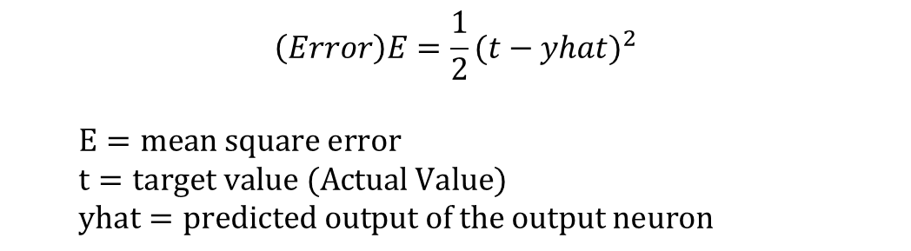
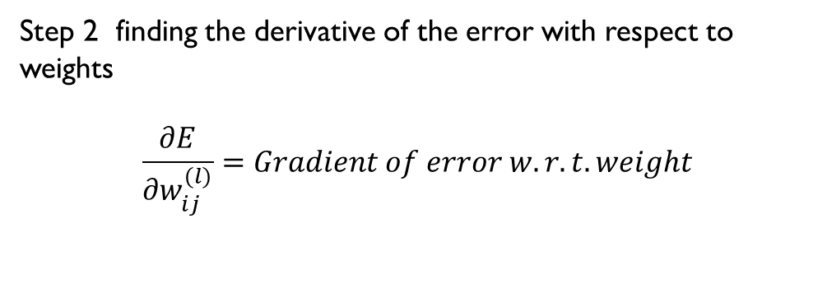
Mathematical Modelling of Neural Network
$$x_{0}$$
$$w_{10}^{(1)}$$
$$x_{1}$$
$$w_{11}^{(1)}$$
$$a_{1}^{(2)}$$
$$a_{0}^{(2)}$$
$$w_{31}^{(1)}$$
$$w_{21}^{(1)}$$
$$\left(Error\right)E=\frac{1}{2}{(t−yhat)}^{2}$$
$$E=mean square error$$
$$t=target value (Actual Value)$$
$$yhat=predicted output of the output neuron$$
$$x_{0}$$
$$w_{11}^{(2)}$$
$$w_{10}^{(2)}$$
$$w_{20}^{(1)}$$
$$w_{12}^{(1)}$$
$$a_{2}^{(2)}$$
$$w_{12}^{(2)}$$
$$x_{2}$$
$$w_{22}^{(1)}$$
$$a_{1}^{(3)}$$
$$w_{32}^{(1)}$$
$$x_{0}$$
$$w_{13}^{(2)}$$
$$w_{30}^{(1)}$$
Step 2 finding the derivative of the error with respect to weights
$$\frac{∂E}{∂w_{ij}^{(l)}}=Gradient of error w.r.t. weight$$
$$w_{13}^{(1)}$$
$$w_{23}^{(1)}$$
$$a_{3}^{(2)}$$
$$x_{3}$$
$$w_{33}^{(1)}$$

Slide 7

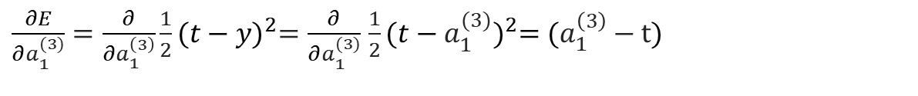
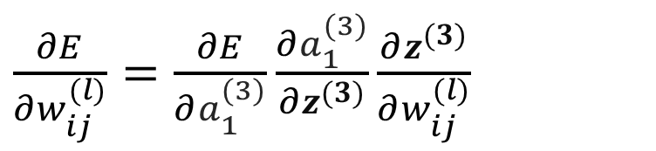

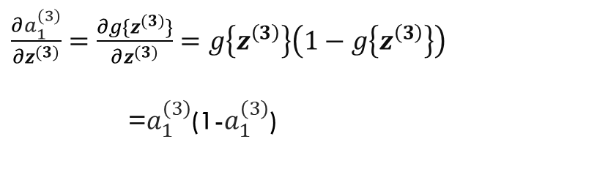

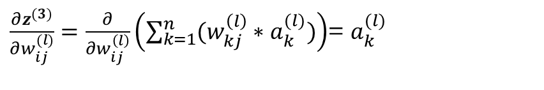




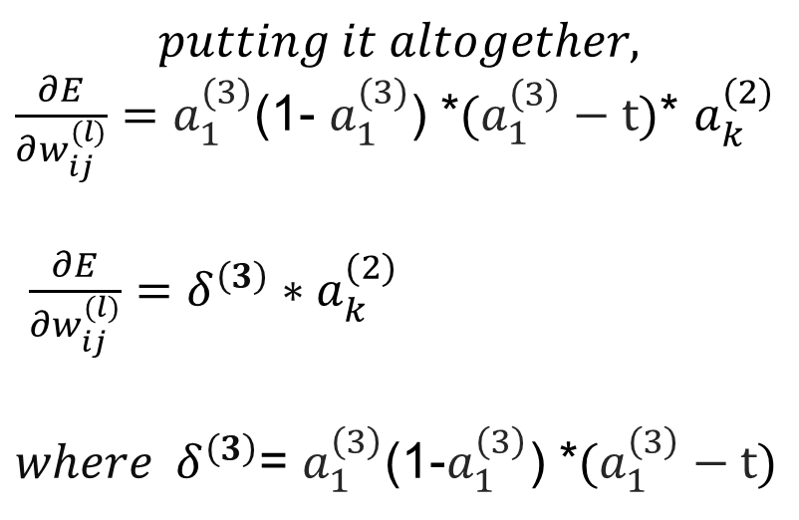
$$w_{11}^{(2)}$$
$E=\frac{1}{2}{(t−yhat)}^{2}$ = $\frac{1}{2}{(t−a_{1}^{(3)})}^{2}$
$\frac{∂E}{∂w_{ij}^{(l)}}=$ $\frac{∂E}{∂a_{1}^{(3)}}\frac{∂a_{1}^{(3)}}{∂z^{(3)}}\frac{∂z^{(3)}}{∂w_{ij}^{(l)}}$
$$a_{1}^{(3)}$$
$$w_{12}^{(2)}$$
$$z^{(3)}$$
$${g\{z}^{(3)}\}$$
$$w_{13}^{(2)}$$
$\frac{∂z^{(3)}}{∂w_{ij}^{(l)}}=\frac{∂}{∂w_{ij}^{\left(l\right)}}\left(\sum_{k=1}^{n}{(w_{kj}^{\left(l\right)}∗a_{k}^{(l)})}\right)$= $a_{k}^{(l)}$
$$putting it altogether,$$
$\frac{∂E}{∂w_{ij}^{(l)}}=$ $a_{1}^{(3)}$(1- $a_{1}^{(3)}$) *$(a_{1}^{\left(3\right)}−t)$* $a_{k}^{(2)}$
$\frac{∂E}{∂w_{ij}^{(l)}}=δ^{\left(3\right)}∗a_{k}^{(2)}$
${where δ}^{\left(3\right)}$= $a_{1}^{\left(3\right)}$(1-$a_{1}^{\left(3\right)}$) *$(a_{1}^{\left(3\right)}−t)$
$\frac{∂a_{1}^{(3)}}{∂z^{(3)}}=$ $\frac{∂g\{z^{(3)}\}}{∂z^{(3)}}=g\left\{z^{\left(3\right)}\right\}\left(1−g\left\{z^{\left(3\right)}\right\}\right)$
=$a_{1}^{\left(3\right)}$(1-$a_{1}^{\left(3\right)}$)
$\frac{∂E}{∂a_{1}^{(3)}}=\frac{∂}{∂a_{1}^{\left(3\right)}}\frac{1}{2}{(t−y)}^{2}=\frac{∂}{∂a_{1}^{(3)}}$ $\frac{1}{2}{(t−a_{1}^{(3)})}^{2}=(a_{1}^{\left(3\right)}−t)$

Slide 8
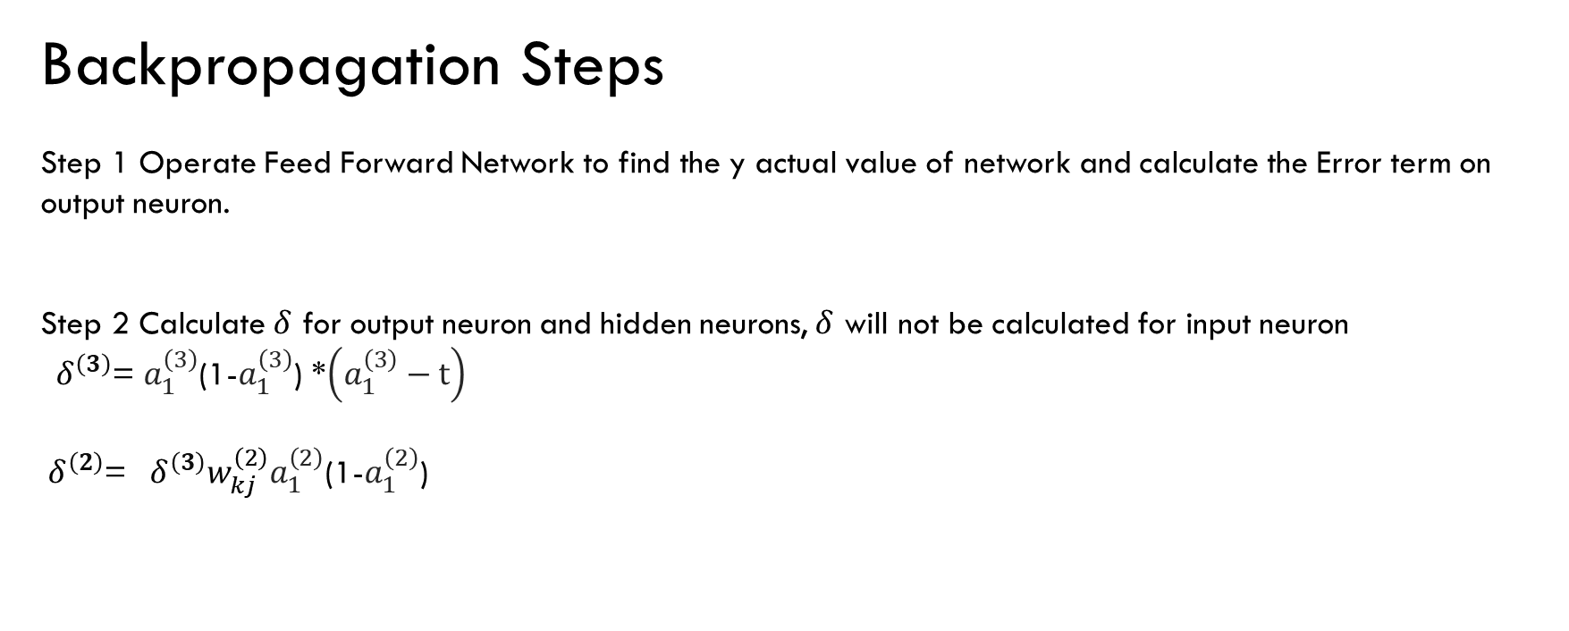
Backpropagation Steps
Step 1 Operate Feed Forward Network to find the y actual value of network and calculate the Error term on output neuron.
Step 2 Calculate $δ$ for output neuron and hidden neurons, $δ$ will not be calculated for input neuron
${ δ}^{\left(3\right)}$= $a_{1}^{\left(3\right)}$(1-$a_{1}^{\left(3\right)}$) *$\left(a_{1}^{\left(3\right)}−t\right)$
${ δ}^{\left(2\right)}$= ${{ δ}^{\left(3\right)}w_{kj}^{\left(2\right)}a}_{1}^{\left(2\right)}$(1-$a_{1}^{\left(2\right)}$)

Slide 9
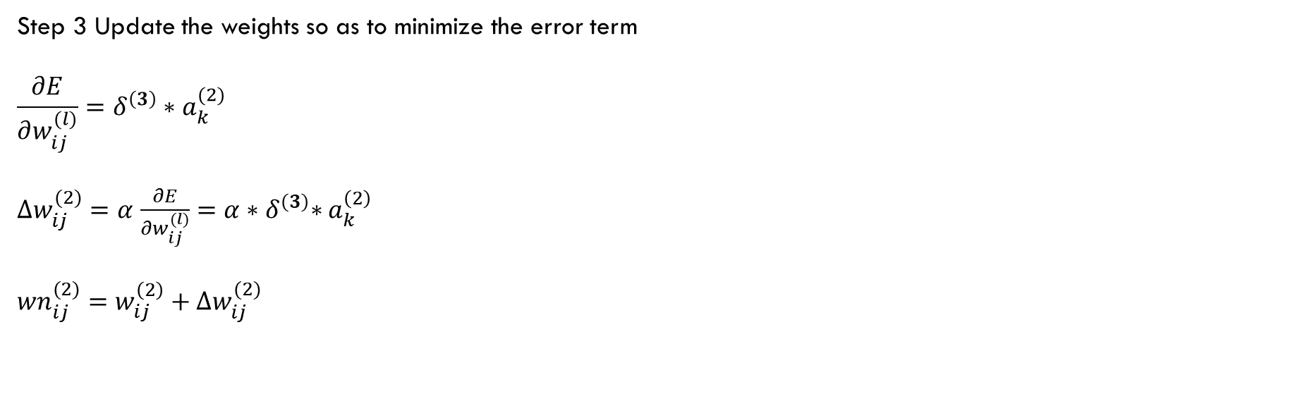
Step 3 Update the weights so as to minimize the error term
$$\frac{∂E}{∂w_{ij}^{(l)}}=δ^{\left(3\right)}∗a_{k}^{(2)}$$
$∆w_{ij}^{(2)}=α$ $\frac{∂E}{∂w_{ij}^{(l)}}=α{∗δ}^{\left(3\right)}∗a_{k}^{\left(2\right)}$
$${wn}_{ij}^{(2)}=w_{ij}^{\left(2\right)}+∆w_{ij}^{(2)}$$

Slide 10
The back-propagation training algorithm
Step 1: Initialization
Set all the weights and threshold levels of the network to random numbers uniformly distributed inside a small range:
where F_{i} is the total number of inputs of neuron i in the network. The weight initialization is done on a neuron-by-neuron basis.

Slide 11
Three-layer network
w13 = 0.5, w14 = 0.9, w23 = 0.4, w24 = 1.0,
w35 = −1.2, w45 = 1.1, θ3 = 0.8, θ4 = −0.1 and θ5 = 0.3

Slide 12
The effect of the threshold applied to a neuron in the hidden or output layer is represented by its weight, θ, connected to a fixed input equal to −1.
The initial weights and threshold levels are set randomly e.g., as follows:
w₁₃ = 0.5, w₁₄ = 0.9, w₂₃ = 0.4, w₂₄ = 1.0, w₃₅ = −1.2, w₄₅ = 1.1, θ₃ = 0.8, θ₄ = −0.1 and θ₅ = 0.3.

Slide 13
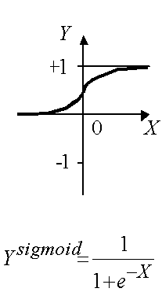
Assuming the sigmoid activation Function

Slide 14
Step 2: Activation
Activate the back-propagation neural network by applying inputs x₁(p), x₂(p),…, x_{n}(p) and desired outputs y_{d,1}(p), y_{d,2}(p),…, y_{d,n}(p).
(a) Calculate the actual outputs of the neurons in the hidden layer:
where n is the number of inputs of neuron j in the hidden layer, and sigmoid is the sigmoid activation function.

Slide 15
Step 2: Activation (continued)
(b) Calculate the actual outputs of the neurons in the output layer:
where m is the number of inputs of neuron k in the output layer.

Slide 16
If the sigmoid activation function is used the output of the hidden layer is
And the actual output of neuron 5 in the output layer is
And the error is

Slide 17
What learning law applies
in a multilayer neural network?

Slide 18
Step 3: Weight training output layer
Update the weights in the back-propagation network propagating backward the errors associated with output neurons.
(a) Calculate the error
and then the error gradient for the neurons in the output layer:
Then the weight corrections:
Then the new weights at the output neurons:

Slide 19
Three-layer network for solving the Exclusive-OR operation

Slide 20
The error gradient for neuron 5 in the output layer:
Determine the weight corrections assuming that the learning rate parameter, α, is equal to 0.1:

Slide 21
Step 3: Weight training hidden layer
(b) Calculate the error gradient for the neurons in the hidden layer:
Calculate the weight corrections:
Update the weights at the hidden neurons:

Slide 22
The error gradients for neurons 3 and 4 in the hidden layer:
Determine the weight corrections:

Slide 23
At last, we update all weights and threshold:
w
=
w
+
Δ
w
=
0
.
5
+
0
.
0038
=
0
.
5038
13
13
13
w
=
w
+
Δ
w
=
0
.
9
−
0
.
0015
=
0
.
8985
14
14
14
w
=
w
+
Δ
w
=
0
.
4
+
0
.
0038
=
0
.
4038
23
23
23
w
=
w
+
Δ
w
=
1
.
0
−
0
.
0015
=
0
.
9985
24
24
24
w
=
w
+
Δ
w
=
−
1
.
2
−
0
.
0067
=
−
1
.
2067
35
35
35
w
=
w
+
Δ
w
=
1
.
1
−
0
.
0112
=
1
.
0888
45
45
45
θ
=
θ
+
Δ
θ
=
0
.
8
−
0
.
0038
=
0
.
7962
3
3
3
θ
=
θ
+
Δ
θ
=
−
0
.
1
+
0
.
0015
=
−
0
.
0985
4
4
4
θ
=
θ
+
Δ
θ
=
0
.
3
+
0
.
0127
=
0
.
3127
5
5
5
The training process is repeated until the sum of squared errors is less than 0.001.

Slide 24
Step 4: Iteration
Increase iteration p by one, go back to Step 2 and repeat the process until the selected error criterion is satisfied.
As an example, we may consider the three-layer back-propagation network. Suppose that the network is required to perform logical operation Exclusive-OR. Recall that a single-layer perceptron could not do this operation. Now we will apply the three-layer net.

Slide 25
Typical Learning Curve

Slide 26
Final results of three-layer network learning

Slide 27
Accelerated learning in multilayer neural networks
A multilayer network learns much faster when the sigmoidal activation function is represented by a hyperbolic tangent:
where a and b are constants.
Suitable values for a and b are:
a = 1.716 and b = 0.667

Slide 28
We also can accelerate training by including a momentum term in the delta rule:
where β is a positive number (0 ≤ β < 1) called the momentum constant. Typically, the momentum constant is set to 0.95.
This equation is called the generalised delta rule.

Slide 29
Learning with an adaptive learning rate
To accelerate the convergence and yet avoid the
danger of instability, we can apply two heuristics:
Heuristic
If the error is decreasing the learning rate α, should be increased.
If the error is increasing or remaining constant the learning rate α, should be decreased.

Slide 30
Adapting the learning rate requires some changes in the back-propagation algorithm.
If the sum of squared errors at the current epoch exceeds the previous value by more than a predefined ratio (typically 1.04), the learning rate parameter is decreased (typically by multiplying by 0.7) and new weights and thresholds are calculated.
If the error is less than the previous one, the learning rate is increased (typically by multiplying by 1.05).

Slide 31
Typical Learning Curve

Slide 32
Typical learning with adaptive learning rate

